Slide 1

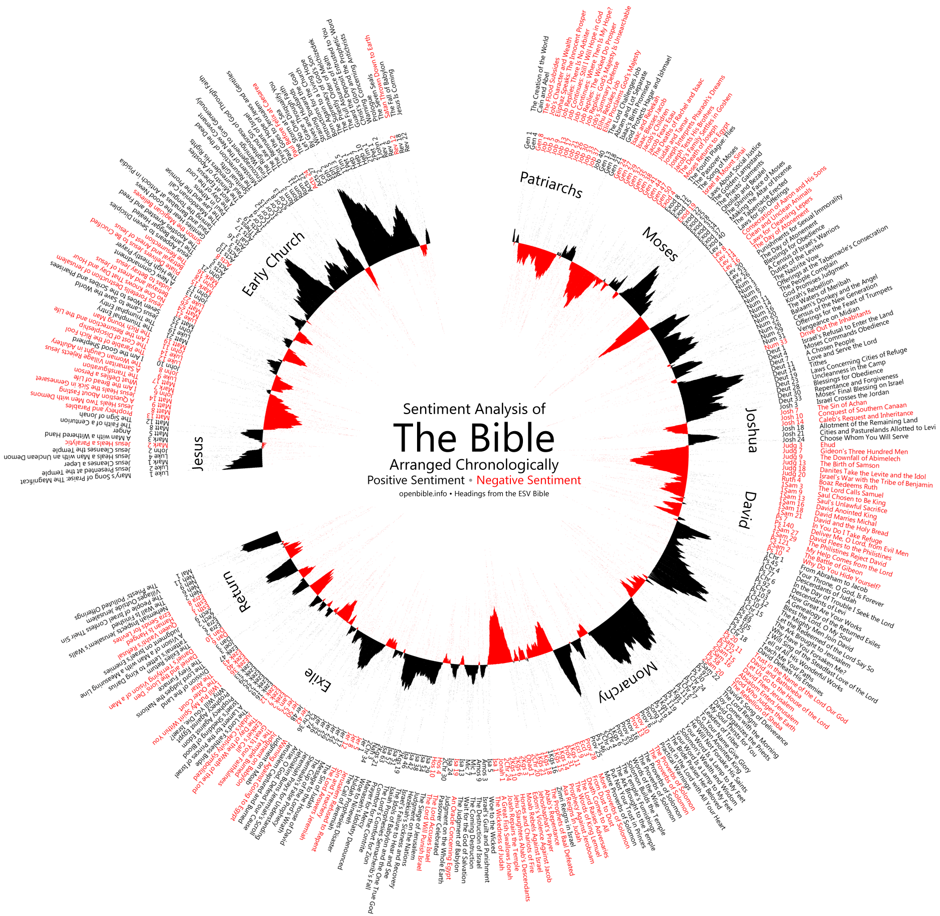







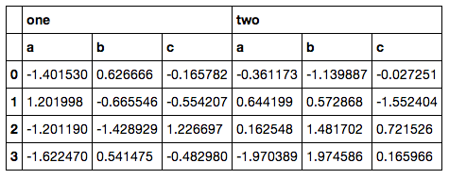




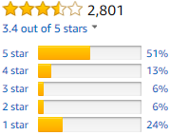
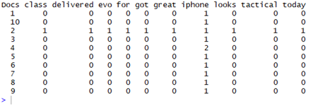

Using Binary Classifier for Predicting Success of
Technology Release Based Upon Sentiment Analysis of Social Media Data
Ali Akbar Jilani¹
Waterford Institute of Technology, Cord Road, Waterford, Ireland
Abstract
Hypothesis 1
Data Gathering
User Generated Content (UGC) over social media can be tapped to extract underlying public sentiment and take relevant actions. Proposed study uses sentiment analysis on twitter data to investigate its correlation with sentiments of same products as measured through Amazon user reviews. The study goes further into supervised machine learning techniques to train a binary classifier on the patterns of sentiment words occurring in the same twitter data to test its correspondence with online user reviews in the technology product domain.
S₁
Click here to insert your Discussion text. Type it in or copy and paste from your Word document or other source.
This text box will automatically re-size to your text. To turn off that feature, right click inside this box and go to Format Shape, Text Box, Autofit, and select the “Do Not Autofit” radio button.
To change the font style of this text box: Click on the border once to highlight the entire text box, then select a different font or font size that suits you. This text is Calibri 32pt and is easily read up to 5 feet away on a 36x48 poster.
twitteR Package
Sentiment Analysis
Document Level
S₂
Negative Lexicon
Positive Lexicon
Bag of Words
S_{1k}
twitteR Package
Data Frame
Data Cleaning
TEXT VECTOR
Research Question
TEXT VECTOR
The purpose of this research is to measure public sentiments expressed by twitter users in the form of tweets posted about their experiences of technology, and to tally these sentiments with their equivalents of technology reviews found in sites such as Amazon. This research investigate the correlation between these sentiments as recorded through both the above sources. The underlying research question can therefore be defined as the following.
"Does aggregate social media sentiment agree with online user reviews of technology?"
Bag of Words
#Hashtag
RT
@username
Corpus
TEXT VECTOR
Summary Row – S. Scores
Document Term Matrix - DTM
Data Cleaning Activities
Click here to insert your Conclusions text. Type it in or copy and paste from your Word document or other source.
This text box will automatically re-size to your text. To turn off that feature, right click inside this box and go to Format Shape, Text Box, Autofit, and select the “Do Not Autofit” radio button.
Pearson’s ( r )
Research Methodology
Click here to insert your Results text. Type it in or copy and paste from your Word document or other source.
To change the font style of this text box: Click on the border once to highlight the entire text box, then select a different font or font size that suits you. This text is Calibri 32pt and is easily read up to 5 feet away on a 36x48 poster.
Zoom out to 100% to preview what this will look like on your printed poster.
Speaking of Results, yours will look better if you remember to run a spell-check on your poster! After you’ve added your content click on Review, Spelling, or press F7.
As part of this study, it is hypothesized that
Hypothesis 1: Aggregate sentiment analysis score on social media will correlate to aggregate online user reviews of technology.
Sentiment Analysis Algorithm employed as part of this study will make use of a set of sentiment lexicons [10] (positive and negative lexicons) of different sentiment words to gauge the aggregate sentiment of a corpus related to a specific technology product release. Average star rating as taken from online reviews site (e.g. Amazon) is as such a measure of public sentiment about the same technology product released but on a different scale. It is hypothesized that there is a correlation between both the sentiment scores.
Hypothesis 2: Binary Classification could be used to classify social media sentiment as positive or negative in a way that corresponds with online user reviews of technology.
Instead of aggregate sentiment score, our binary classification model [1] such as SVM or Perceptron will be fed with twitter data. All the words in twitter corpus related to a specific technology product release will serve as variables while their frequencies of occurrence in the corpus will be treated as values. Our model will be trained using supervised learning [13] to be told if the overall set of words and values corresponds to success or to failure (calculated through the average online review on Amazon as a side process). Twitter corpora relating to a minimum of 10 technology products released will be used to develop a learning for our model using training data. Training data will be taken out of the harvested tweets and would represent 80% of the overall corpus size. Test data would be represented by rest of the 20% data. Upon successful learning, the same model will be utilized in predicting the outcome against a test data partition in terms of either of success or failure. Results will be compared with online user reviews. It is hypothesized that the binary outcome of our model actually corresponds with online user reviews.
Future Directions
Theory/ Hypotheses
Click here to insert your Future Directions text. Type it in or copy and paste from your Word document or other source.
This text is Calibri 32pt and is easily read up to 5 feet away on a 36x48 poster.
Hypothesis 1: Aggregate sentiment analysis score on social media will correlate to aggregate online user reviews of technology.
Hypothesis 2: Binary Classification could be used to classify social media sentiment as positive or negative in a way that corresponds with online user reviews of technology.
Contact Information
References
Acknowledgements
Ali Jilani
Waterford Institute of Technology,
Department of Science & Computing
Email:20078735@mail.wit.ie
https://www.youtube.com/watch?v=LOuu0CN4sjc
Acknowledgements text goes here.

